Slide 1
VALIDATE EMBEDDED SYSTEMS REQUIREMENTS
WITH REQUIREMENT-IN-THE-LOOP SIMULATION

Slide 2

Argosim Company Profile
ARGOSIM: Independant Software Vendor created in 2013
  Etienne Closse (… - France Telecom – Athys – DS)
  Daniel Weil (PhD France Telecom – Athys – DS)
  Fabien Gaucher (PhD Verimag – Athys – DS)
  Bertrand Jeannet (PhD Verimag – INRIA)
Technology based on academic research results: VERIMAG / ENS / INRIA
STIMULUS released in early 2015.
STIMULUS users in automotive, transportation, avionics, energy.
International presence.

Slide 3
The Requirements Engineering Challenge
Embedded system requirements are written by hand.
No requirements validation tool exists.
70% of design bugs are caused by faulty requirements.
Notes:
I want to start by showing you two graphs that you will know very well. The graph on the left shows the percentage of errors introduced at the various stages of the development cycle and the one on the right shows the cost to a business of correcting an error during the development cycle. We are all fully aware of the shape of these graphs and they haven’t changed for 20 years. That does concern me a little, but more of that later.
Highlight that time is money and the right hand graph could be changed to show that the time spent at each phase directly correlates to the cost

Slide 4
Known Facts in the Embedded System Industry
Most of the defects are introduced very early but detected very late,
generating extremely costly iterations of the development cycle
!
(source: IBM Systems Sciences Institute)
Notes:
I want to start by showing you two graphs that you will know very well. The graph on the left shows the percentage of errors introduced at the various stages of the development cycle and the one on the right shows the cost to a business of correcting an error during the development cycle. We are all fully aware of the shape of these graphs and they haven’t changed for 20 years. That does concern me a little, but more of that later.
Highlight that time is money and the right hand graph could be changed to show that the time spent at each phase directly correlates to the cost

Slide 5









Trends of Safety-critical Embedded Systems
The trend in embedded systems industries is towards
autonomous and ever increasingly complex systems
with the automotive industry leading the way
Engineers cannot master this complexity any more!

Slide 6

Example of Unexpected System Behaviour
Volvo demo to journalists – Automated Braking System
Notes:
You know that they would have tested this! There’s no way you’re going to put the CEO in front of a moving vehicle unless you’re confident that it’s going to stop. Yet even so ….

Slide 7
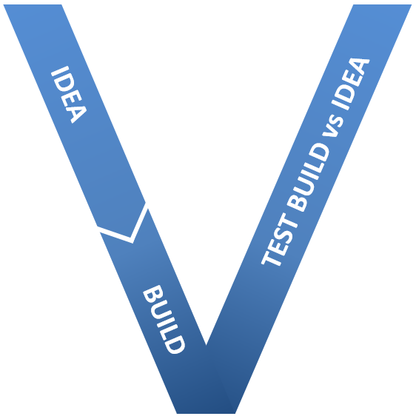










The “V” Cycle and Tools
Requirement Management Tools
Integration Test Tools
Model-Based System Engineering Tools
Automated Testing Tools
Simulation and Code Generation Tools
Automated Checking Tools
At no point is a tool used to validate the requirements,
which are the corner stone of the system
Notes:
The point that we are trying to convey with this slide is that the current toolsets deployed and the processes followed do not address validating the requirements. Requirements are the corner stone of a system and at no point during the V cycle are they validated.
Requirements writing isn't Requirements Engineering. Requirements are still written in Word and Excel, which are products that have been co-opted and are not fit for purpose.
Requirements Management and Requirements Traceabilty aren't Requirements Engineering either, valuable though they may be.
Also, even a set of formally proved requirements doesn't guarantee that the behaviour of the system is as expected.
Current products do not answer the Fundamental questions.
Does my system, as I've described it, do what I mean it to do?
Have I written anything conflicting?
Have I missed anything?
Is what I've written completely unambiguous?
If these can't be answered then anything generated from them is almost certainly flawed and nothing can be validated by them.

Slide 8
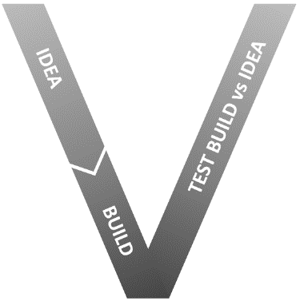
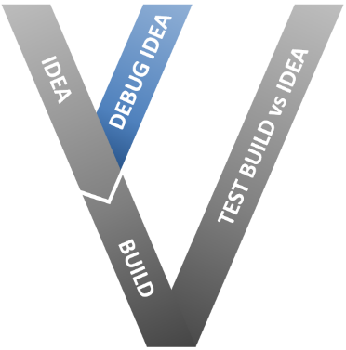
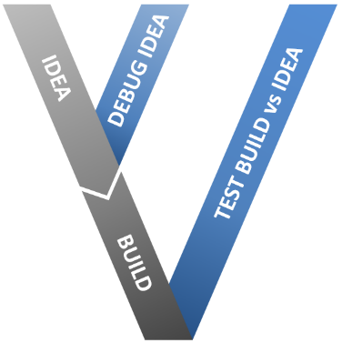
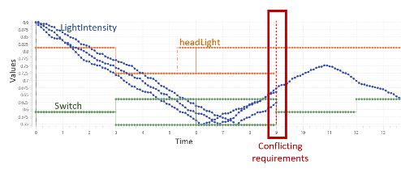
A new paradigm – Requirements-In-the-Loop
Simulation is the key for validating requirements
Simulation of requirements allows for the
early validation of system specifications
Code can be stimulated with
automatically generated test vectors and checked against requirements
Test Vectors
SUT
(generated)
Code or FMU
Observers
Requirements
& coverage metrics
Notes:
Model Based Requirements Engineering would allow us to validate the requirements automatically. We would
Know that the system behaved how we wanted it to.
Know there weren't any conflicting requirements.
Confirm safety requirements were being met.
Ensure that low level requirements weren’t violating high level requirements.
Ensure that requirements hadn’t been missed
Provide the designers, developers and testers with an unambiguous set of requirements.

Slide 9

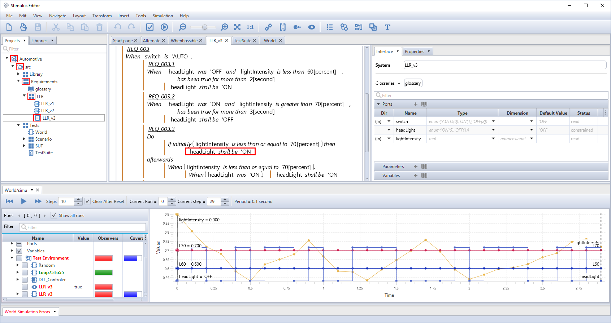
Argosim Value Proposition
is the first simulation tool that allows to detect
ambiguous, incorrect, missing and conflicting requirements

Slide 10
Functional Systems Requirements
Requirements = WHAT a system shall do, not HOW
Example: automotive headlights
REQ_001: When switch is OFF, headlights shall be OFF
REQ_002: When switch is ON, headlights shall be ON
REQ_003: When switch is AUTO, headlights shall not blink
  REQ_003A: When switch is AUTO, headlights are ON, and light intensity is above 70%, then headlights shall be OFF if this condition lasts for more than 3 seconds
  REQ_003B: When switch is turned to AUTO, and light intensity is below 70%, then headlights shall be ON. Afterwards headlights shall stay ON as long as light intensity is not above 70%
  …
ON
OFF
AUTO

Slide 11

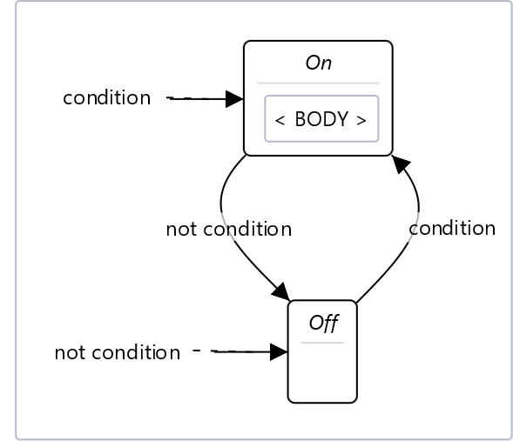

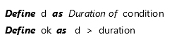
Writing Requirements in STIMULUS
Write unambiguous requirements by composing sentences with predefined, customisable templates…
that have executable semantics

Slide 12
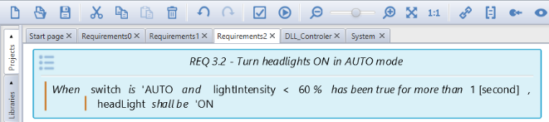

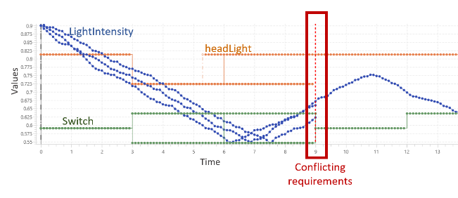

Simulating Requirements in STIMULUS
Scenarios
Requirements
Detect faulty requirements by observing their behaviour

Slide 13
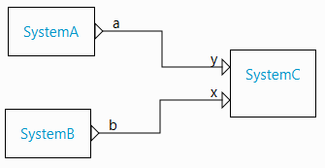
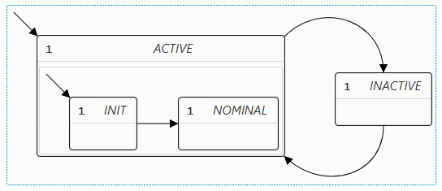
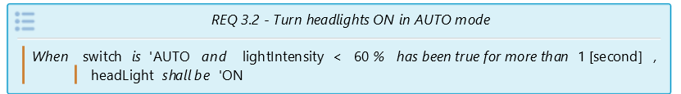
Simulating Requirements: behind the scene
+
+
Build Time
R2(x,y)
Control flow graph:
Actions = logico-numerical constraints & assignements
Logical & Physical time management
R1(x,y)
R4(x,y)
R3(x,y)
Run Time
Sequence of:
- Non-linear assignements
- Linear constraints solved with
BDD + convex polyedra
… y:=F(x); R(z,x,y); …

Slide 14

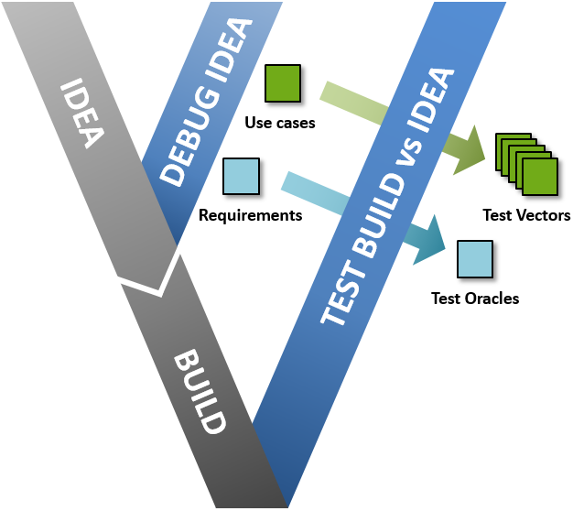
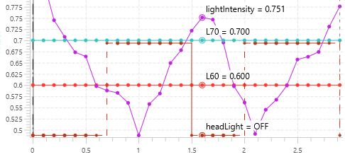
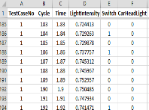

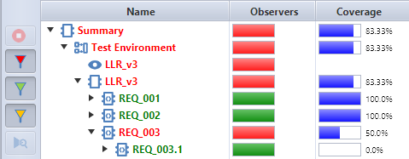
From Requirements to System Validation
FMU
Use Cases
Requirements
Test vectors
(stimuli)
System Under Test
Observers (Oracles)
Edit your system requirements,
Simulate them against use cases,
Detect faulty requirements
Import your system code,
Generate test vectors and
Detect violated requirements automatically

Slide 15
Where does STIMULUS come from ?
Lustre (CNRS) / Scade (EsterelTech/ANSYS)
LucidSynchrone (Paris 6)
Real-time system programming
Lurette (VERIMAG/CNRS)
Simulating test environments
Lutin (VERIMAG/CNRS)
Modeling test environments

Slide 16
STIMULUS Language: Genealogical table
Lustre: synchronous data-flow programming
1984: Nicolas Halbwachs: Modélisation et analyse du comportement des systèmes informatiques temporizes. Thèse d’état
Résumé: Étude d'un modèle mathématique pour formaliser le comportement des systèmes parallèles et temps réel, à des fins de spécification de problèmes, de description, d'analyse et de preuve de réalisations. Construction, à partir des mêmes notions, d'un calcul formel conduisant à des méthodes systématiques d'analyse de systèmes logiques temporisés, au niveau algorithmique
1985: Bergerand, Caspi, Pilaud, Halbwachs, Pilaud:
Outline of a Real Time Data Flow Language. RTSS 1985
1987: Caspi, Pilaud, Halbwachs, Plaice:
Lustre: A Declarative Language for Programming Synchronous Systems. POPL 1987
1991: Halbwachs, Raymond, Ratel:
Generating Efficient Code From Data-Flow Programs. PLILP 1991

Slide 17
STIMULUS Language: Genealogical table
Adding more to Lustre: type inference a la ML and more
1999: Caspi, Pouzet.
Lucid Synchrone: une extension fonctionnelle de Lustre. JFLA 1999
2000: Hamon, Pouzet:
Modular resetting of synchronous data-flow programs. PPDP 2000
2002: Colaço, Pouzet:
Type-Based Initialisation Analysis of a Synchronous Data-Flow Language. ENTCS
Adding more to Lustre: state machines
1998: Maraninchi, Rémond:
Mode-Automata: About Modes and States for Reactive Systems. ESOP 1998
2005: Colaço, Pagano, Pouzet:
A conservative extension of synchronous data-flow with state machines. EMSOFT 2005

Slide 18
STIMULUS Language: Genealogical table
Real-Time Properties (= Functional Requirements)
1993: Halbwachs, Lagnier, Raymond:
Synchronous Observers and the Verification of Reactive Systems. AMAST 1993
Constrained Reactive Programming: Lurette & Lutin
1998: Raymond, Nicollin, Halbwachs, Weber:
Automatic Testing of Reactive Systems. RTSS 1998
2006: Raymond, Jahier, Roux:
Describing and Executing Random Reactive Systems. SEFM 2006
2008: Raymond, Roux, Jahier:
Lutin: A Language for Specifying and Executing Reactive Scenarios. EURASIP JES
2013: Jahier, Halbwachs, Raymond:
Engineering functional requirements of reactive systems using synchronous languages SIES 2013
Debugging Reactive Systems: Ludic
2000: Maraninchi, Gaucher:
Step-wise + Algorithmic debugging for Reactive Programs: Ludic, a debugger for Lustre. AADEBUG 2000

Slide 19
Whats’more in STIMULUS language versus Lustre/Lutin
STIMULUS language in short
Synchronous constraint programming language:
  Data: synchronous data-flow equations & constraints, arrays & iterators
  Control: hierarchical state machines à la Colaço-Pouzet with weighted choices à la Lutin
  Modularity: systems & macros
  Architecture: block-diagrams
Standard Library
Whats’more ?
Causality
  Controlling where a variable is constrained and where it is just read (as in Mercury)
  Infered according to typing and propagation rules
Default behavior
  A variable may remain stable or take a defaut value when « nothing is said on it »
  Involves typing rules
Transforming random signal generators as deterministic signal observers

Slide 20





























STIMULUS Users
www.argosim.com

